Slide 1

Empty Housing Rates in Spain: A Machine Learning Approach to Prediction and Interpretation
Build a supervised regression model capable of predicting the percentage of empty housing units across Spanish municipalities.
Identify the most relevant socio-demographic and economic drivers behind housing vacancy

Slide 2
Modeling and Evaluation Process
1
2
3
4
5
6
ETL
Process
Exploratory
Data Analysis
Feature
Selection
Model
Comparison
Model
Optimization
Final Models
Evaluation
Extract
-INE
-Datos.gob
Transform
-Cleaning
-Encoding
-Merging
Load
Target Distribution
Target Variation Across Different Categorical Groups
The collinearity Problem
Manual Feature
Selection
Selection Through Models
X_train Transformation
Models and Feature Selections Dictionaries
Cross Validation
Test Evaluation
Model And Feature Selection
Grid Search Hyperparameters
Optimization
Prediction Metrics
Feature Importance and SHAP Analysis

Slide 3
Modeling and Evaluation Process
1
2
3
4
5
6
ETL
Process
Exploratory
Data Analysis
Feature
Selection
Model
Comparison
Model
Optimization
Final Models
Evaluation
Extract
-INE
-Datos.gob
Transform
-Cleaning
-Encoding
-Merging
Load
Target Distribution
Target Variation Across Different Categorical Groups
The collinearity Problem
Manual Feature
Selection
Selection Through Models
X_train Transformation
Models and Feature Selections Dictionaries
Cross Validation
Test Evaluation
Model And Feature Selection
Grid Search Hyperparameters
Optimization
Prediction Metrics
Feature Importance and SHAP Analysis

Slide 4
ETL Process
INE
Datos.gob
Total number of homes, occasional use, median energy consumption.
Demographics by age, gender, Province and Region.
Residential mobility indicators.
Unemployment by sector, gender, and age group.
Geographic variables: latitude, longitude, area, perimeter, elevation.
Transform and Merge
DF_ALL_FEATURES

Slide 5
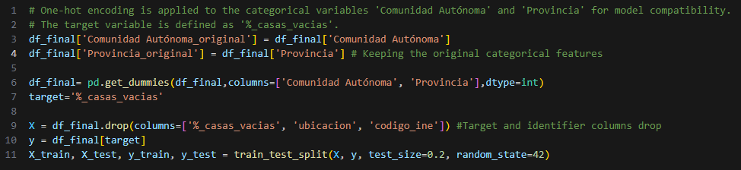
ETL Process

Slide 6
Modeling and Evaluation Process
1
2
3
4
5
6
ETL
Process
Exploratory
Data Analysis
Feature
Selection
Model
Comparison
Model
Optimization
Final Models
Evaluation
Extract
-INE
-Datos.gob
Transform
-Cleaning
-Encoding
-Merging
Load
Target Distribution
Target Variation Across Different Categorical Groups
The collinearity Problem
Manual Feature
Selection
Selection Through Models
X_train Transformation
Models and Feature Selections Dictionaries
Cross Validation
Test Evaluation
Model And Feature Selection
Grid Search Hyperparameters
Optimization
Prediction Metrics
Feature Importance and SHAP Analysis

Slide 7
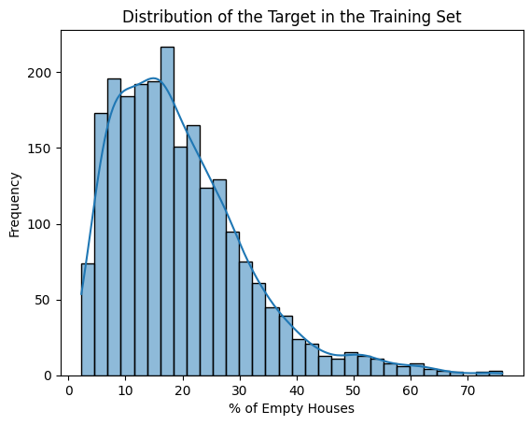
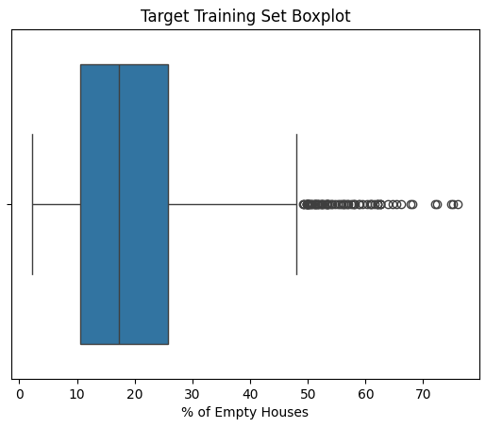
Exploratory Data Analysis: Target

Slide 8
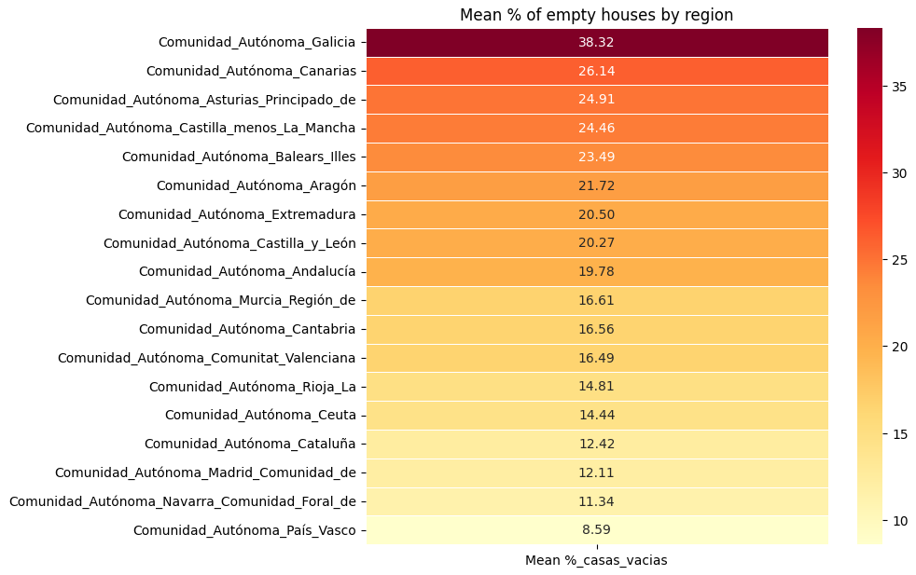
Exploratory Data Analysis: Target Variation across different categorical groups

Slide 9
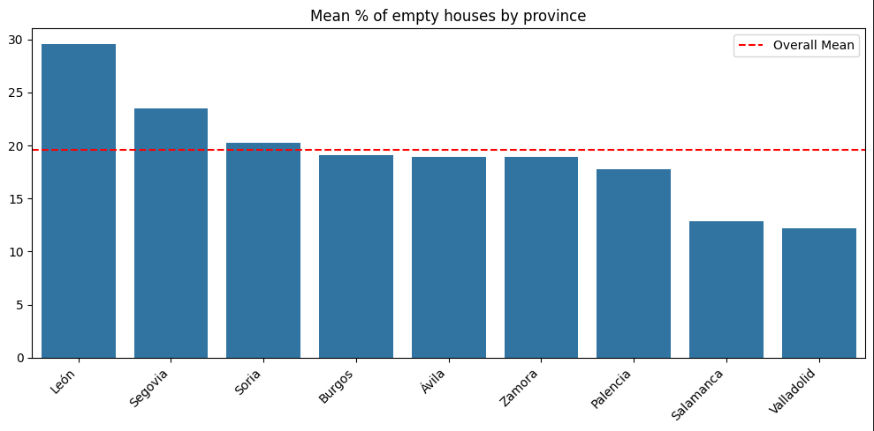
Exploratory Data Analysis:

Slide 10
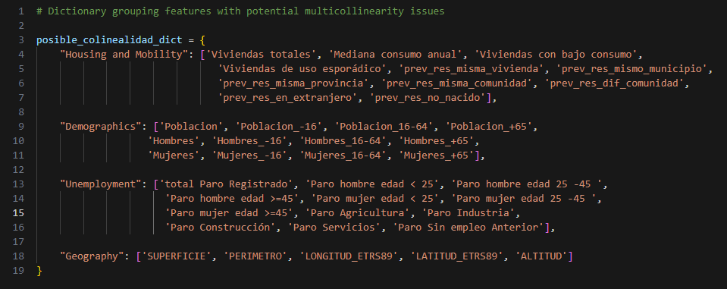
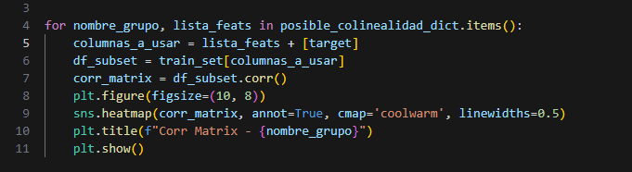
Exploratory Data Analysis: Correlations and multicollinearity among numerical features, especially considering the presence of disaggregated variables

Slide 11
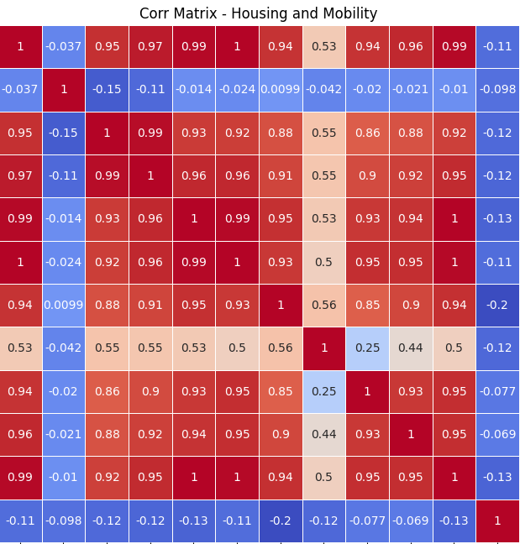
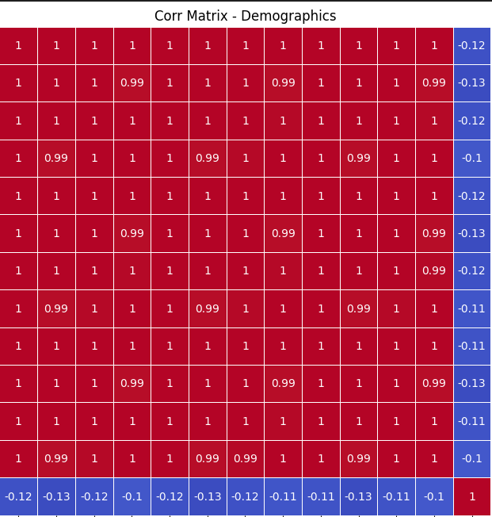
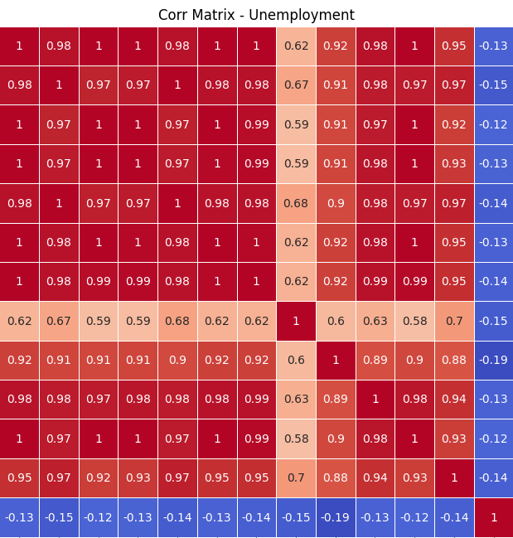
Exploratory Data Analysis: Correlations and multicollinearity among numerical features, especially considering the presence of disaggregated variables

Slide 12
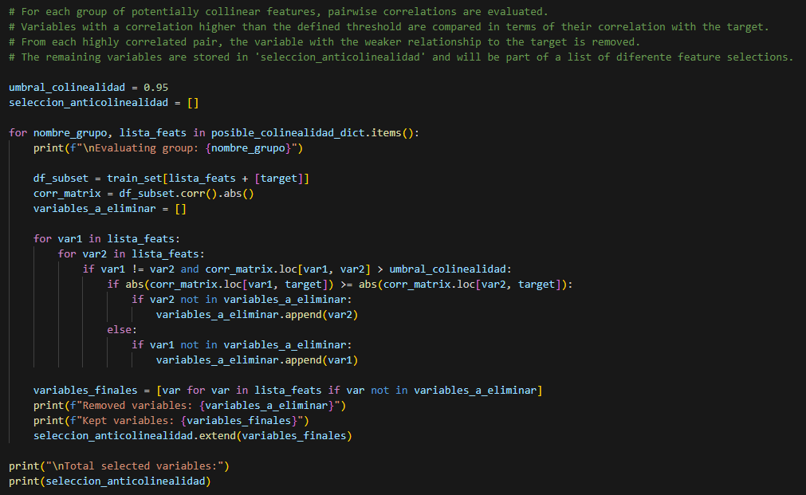
Exploratory Data Analysis: Correlations and multicollinearity among numerical features, especially considering the presence of disaggregated variables

Slide 13
Modeling and Evaluation Process
1
2
3
4
5
6
ETL
Process
Exploratory
Data Analysis
Feature
Selection
Model
Comparison
Model
Optimization
Final Models
Evaluation
Extract
-INE
-Datos.gob
Transform
-Cleaning
-Encoding
-Merging
Load
Target Distribution
Target Variation Across Different Categorical Groups
The collinearity Problem
Manual Feature
Selection
Selection Through Models
X_train Transformation
Models and Feature Selections Dictionaries
Cross Validation
Test Evaluation
Model And Feature Selection
Grid Search Hyperparameters
Optimization
Prediction Metrics
Feature Importance and SHAP Analysis

Slide 14
Feature Selection
Manual selections: Selecciones_features_dic
all_feats – All features available: 111
num_feats – Only numerical non-binary features: 40
seleccion_anticolinealidad – Selected features after collinearity analysis: 14
seleccion_anticol_y_catfeats – Collinearity-filtered + categorical features: 85
Model-based selections:
seleccion_modelo – Custom selection based on feature relevance and collinearity: 56
RFE – Recursive Feature Elimination: 20 / 35 / 50 / 65 / 80
featuresRFECV – Recursive Feature Elimination with Cross-Validation: 12
featuresSFS – Sequential Feature Selection: 9 / 12 / 15 features

Slide 15
Modeling and Evaluation Process
1
2
3
4
5
6
ETL
Process
Exploratory
Data Analysis
Feature
Selection
Model
Comparison
Model
Optimization
Final Models
Evaluation
Extract
-INE
-Datos.gob
Transform
-Cleaning
-Encoding
-Merging
Load
Target Distribution
Target Variation Across Different Categorical Groups
The collinearity Problem
Manual Feature
Selection
Selection Through Models
X_train Transformation
Models and Feature Selections Dictionaries
Cross Validation
Test Evaluation
Model And Feature Selection
Grid Search Hyperparameters
Optimization
Prediction Metrics
Feature Importance and SHAP Analysis

Slide 16
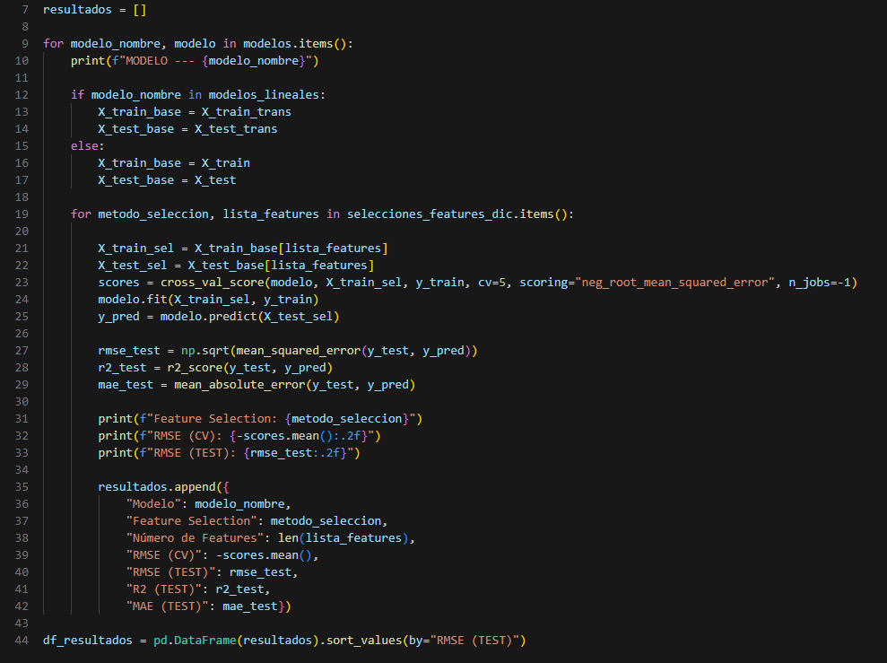
Model Comparison
Feature subsets
Models
Linear models:
-LinearRegression
-Ridge
Tree-based models:
-DecisionTreeRegressor
-RandomForestRegressor
-XGBoost
-LightGBM
-CatBoost
Cross_validation
Test Evaluation
RMSE

Slide 17
Modeling and Evaluation Process
1
2
3
4
5
6
ETL
Process
Exploratory
Data Analysis
Feature
Selection
Model
Comparison
Model
Optimization
Final Models
Evaluation
Extract
-INE
-Datos.gob
Transform
-Cleaning
-Encoding
-Merging
Load
Target Distribution
Target Variation Across Different Categorical Groups
The collinearity Problem
Manual Feature
Selection
Selection Through Models
X_train Transformation
Models and Feature Selections Dictionaries
Cross Validation
Test Evaluation
Model And Feature Selection
Grid Search Hyperparameters
Optimization
Prediction Metrics
Feature Importance and SHAP Analysis

Slide 18
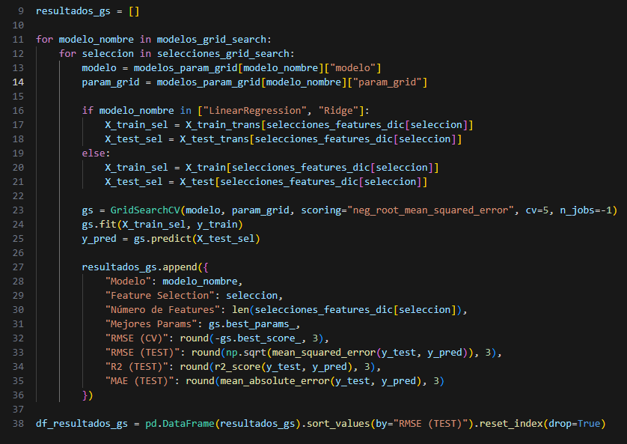

Model Optimization
Feature subsets
-RFE 80 feats
-RFECV 12 feats
Models
Linear models:
-LinearRegression
-Ridge
Tree-based models:
-LightGBM
-CatBoost
Cross_validation
Test Evaluation
RMSE

Slide 19
Modeling and Evaluation Process
1
2
3
4
5
6
ETL
Process
Exploratory
Data Analysis
Feature
Selection
Model
Comparison
Model
Optimization
Final Models
Evaluation
Extract
-INE
-Datos.gob
Transform
-Cleaning
-Encoding
-Merging
Load
Target Distribution
Target Variation Across Different Categorical Groups
The collinearity Problem
Manual Feature
Selection
Selection Through Models
X_train Transformation
Models and Feature Selections Dictionaries
Cross Validation
Test Evaluation
Model And Feature Selection
Grid Search Hyperparameters
Optimization
Prediction Metrics
Feature Importance and SHAP Analysis

Slide 20
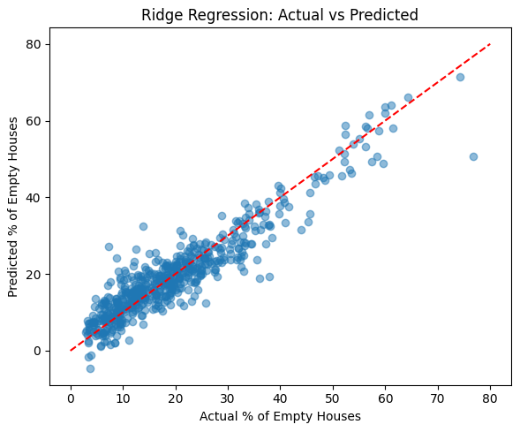
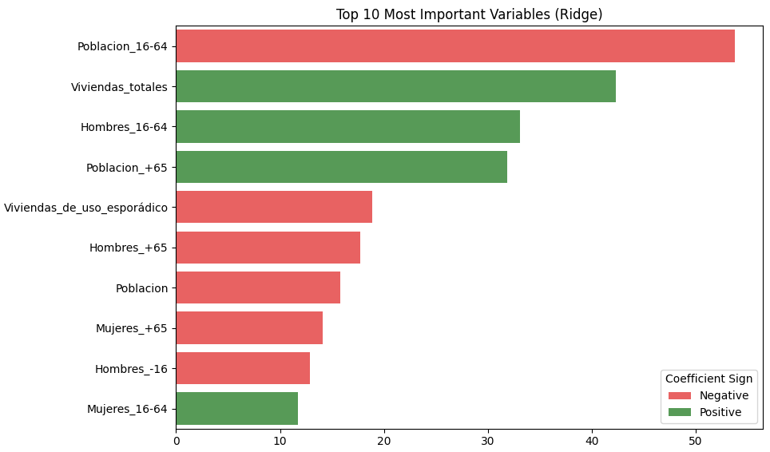
Final Models Evaluation: Optimized RIDGE
RMSE: 4.665
MAE: 3.488
R : 0.866
Feature subset: RFE 80 f
Params: {alpha= 0.01}
Metrics
2

Slide 21
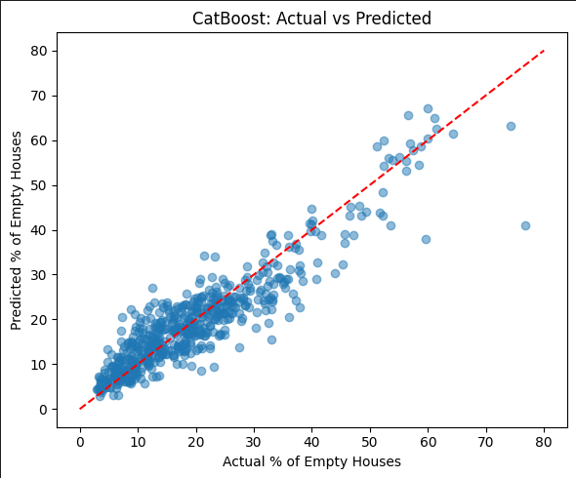
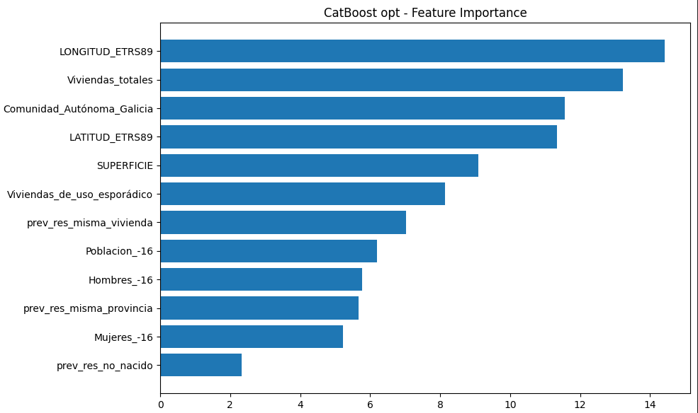
Final Models Evaluation: Optimized CatBoost
RMSE: 4.665
MAE: 3.488
R : 0.866
Feature subset: RFECV 12 f
Params: {depth= 6, iterations= 1000, learning_rate= 0.1}
Metrics
2

Slide 22
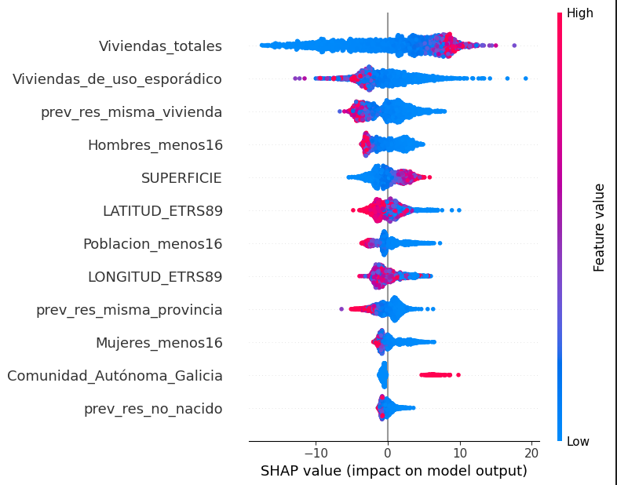


Final Models Evaluation: Optimized CatBoost
Total housing stock -->
Occasional-use properties -->
Residential stability -->
Population under 16 -->
Large territory-->
Western & Northern location -->
Regional factor: Galicia -->

